Slide 1
Functions Part 2
- By
Hemlata Kohin

Slide 2
Today’s Objectives
• To introduce value-returning functions
–Common problems
–Solutions to common problems
• To better grasp how values in the scope of a function actually work
• To practice function calls

Slide 3
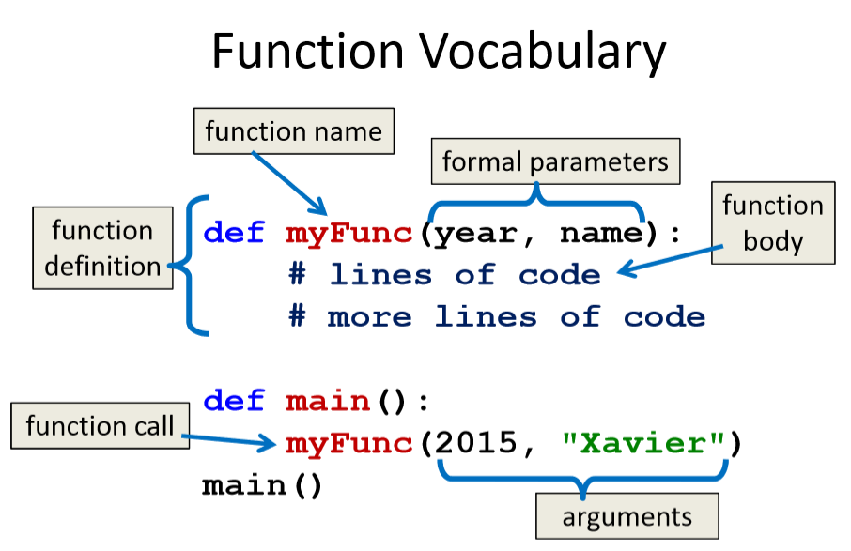
Review

Slide 4
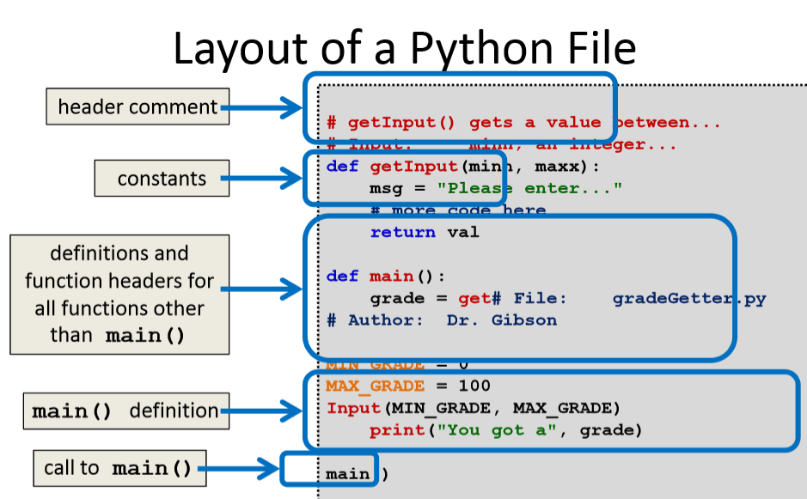

Slide 5
Note On Global Constants
• Globals are variables declared outside of any function (including
main())
• Accessible globally in your program
–To all functions and code
• Your programs may not have global variables
• Your programs may use global constants
–In fact, constants should be global

Slide 6
Return Statements

Slide 7
Giving Information to a Function
• Passing parameters provides a mechanism for initializing the variables in a function
• Parameters act as inputs to a function
• We can call a function many times and get different results by changing its parameters

Slide 8
Getting Information from a Function
• We’ve already seen numerous examples of functions that return values
int(), len(), input(), etc
• For example, len()
–Takes in any list or string as its parameter
–Counts the number of elements (or characters)
–And returns an integer value

Slide 9
Functions that Return Values
• To have a function return a value after it is called, we need to use the return keyword
def square(num):
ans = num * num
# return the square
return ans

Slide 10
Handling Return Values
• When Python encounters return, it...
–Exits the function (immediately!)
• Even if it’s not the end of the function
–Returns control back to where the function was called from
• The expression in the return statement is evaluated, then sent back to the caller as a return value

Slide 11
Code Trace: Return from square()
Let’s follow the flow of the code
def square(num):
ans = num * num
return ans
def main():
x = 5
y = square (x)
print (y)
main()

Slide 12
Code Trace: Return from square()
Step 1: Call main()
Step 2: Pass control to def main()
Step 3: Set x = 5
Step 4: See the function call to square()
Step 5: Pass control from main()to square(), sending the argument 5 Step 6: Set the value of the formal parameter num in square()to 5 Step 7: Calculate ans = num * num
Step 8: Return the value 25 to main()and set y = the returned value Step 9: Print value of y

Slide 13
None and Common Problems

Slide 14
Every Function Returns Something
• All Python functions return a value
–Even if they don’t have a return statement
• Functions without an explicit return pass back a special object, called None
– None is the absence of a value

Slide 15
Example
• Here is a simple toy example:
def multiply(num1, num2):
print("doing", num1, "*", num2)
answer = num1 * num2
return answer
• Assume that this code is in main():
product = multiply(6, 3)
print("result is", product)

Slide 16
Problem #1
• Forgetting to write a return statement
def multiply(num1, num2):
print("doing", num1, "*", num2)
answer = num1 * num2
product = multiply(3, 5)
print("result is", product)
• What is the code’s output now?

Slide 17
Output:
The variable given the return value has a value of none
Doing 3 * 5 will return the value none

Slide 18
Problem #2
• Forgetting to assign the returned value
def multiply(num1, num2):
print("doing", num1, "*", num2)
return num1 * num2
multiply(7, 8)
print("result is", product)
• What is the code’s output now?

Slide 19
Problem #2
Doing 7 * 8 will give an error [Syntax Error]
Should have assigned product to the return value of multiply
Correction would be :
product = multiply(7, 8)

Slide 20
Common Errors and Problems
• If your value-returning functions produce strange messages, check to make sure you used the return correctly!
TypeError: unsupported operand type(s) for *: 'NoneType' and 'int’
TypeError: 'NoneType' object is not iterable

Slide 21
“Modifying” Parameters

Slide 22
Bank Interest Example
• Suppose you are writing a program that manages bank accounts
• One function we would need to create is one to accumulate interest on the account
def addInterest(balance, rate):
newBalance = balance * (1 + rate)
balance = newBalance

Slide 23
Bank Interest Example
def addInterest(balance, rate):
newBalance = balance * (1 + rate)
balance = newBalance
def main():
amount = 1000
rate = 0.05
addInterest(amount, rate)
print(amount)
main()
What is the output of the code?
1000
Is this what we wanted to happen?

Slide 24
What’s Going On?
• It was intended that the 5% would be added to the amount, returning $1050
• Was $1000 the desired output?
• No –so what went wrong?
• This is a very common mistake to make!
–Let’s trace through the code and figure it out

Slide 25
Tracing the Bank Interest Code
• First, we create two variables that are local to main()
def addInterest(balance, rate):
newBalance = balance * (1 + rate)
balance = newBalance
def main():
amount = 1000
rate = 0.05
addInterest(amount, rate)
print(amount)
main()
Local Variables

Slide 26
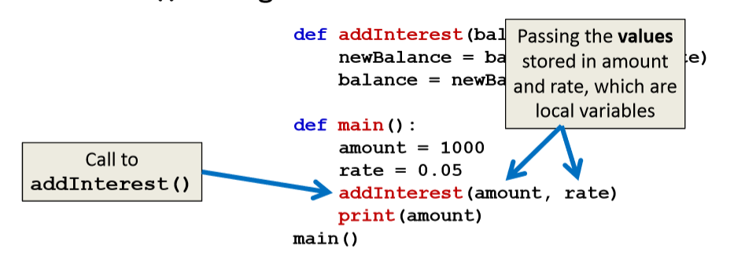
Tracing the Bank Interest Code
• Second, we call addInterest() and pass the values of the local variables of main() as arguments

Slide 27
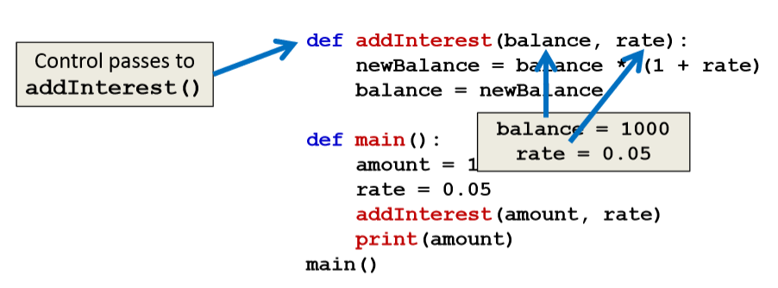
Tracing the Bank Interest Code
• Third, when control is passed to addInterest(), the formal parameters (balance and rate) are set to the value of the arguments (amount and rate)

Slide 28
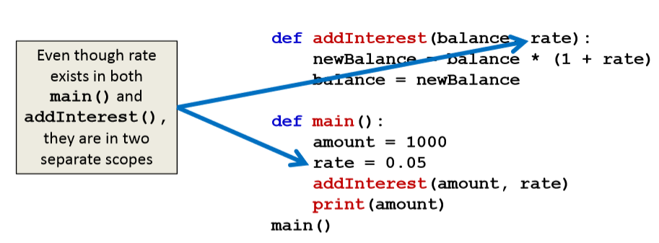
Tracing the Bank Interest Code
• Even though the parameter rateappears in both main()and addInterest(),they are two separatevariables because of scope

Slide 29
Scope
• In other words, the formal parameters of a function only receive the values of the arguments
• The function does not have access to the original variable in main()

Slide 30
New Bank Interest Code
def addInterest(balance, rate):
newBalance = balance * (1 + rate)
return newBalance
def main():
amount = 1000
rate = 0.05
amount = addInterest(amount, rate)
print(amount)
main()
‘Return newBalance’ and ‘amount= ’ these are the only changed parts in the new code

Slide 31
Any Questions?

